Slide 1


Slide 2

Project: Unsupervised Machine Learning
Participants:
Spyros Spyridon
Stavros Doundoulakis
Using data from our database, we trained an algorithm to provide the company with useful insights.

Slide 3
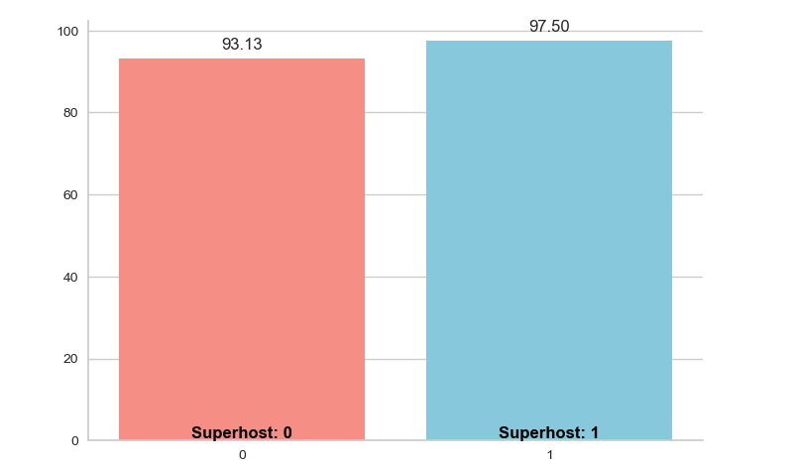
Mean Guest Satisfaction by Host / Superhost Status
Superhost:
1. Host at least 10 trips or have 3 reservations that total at least 100 nights.
2. Maintain a 90% response rate or higher.
3. Maintain a 1% cancellation rate (1 cancellation per 100 reservations) or lower.
4. Maintain a 4.8 overall rating.

Slide 4
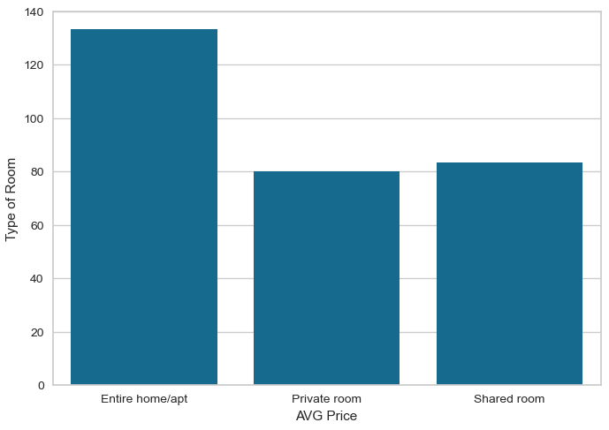
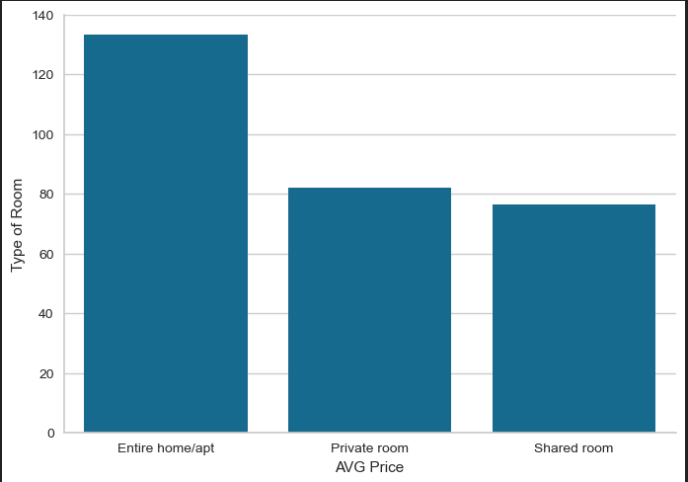
Average Price for Types of Listings
During Weekends
Average Price for Types of Listings
During Weekdays

Slide 5
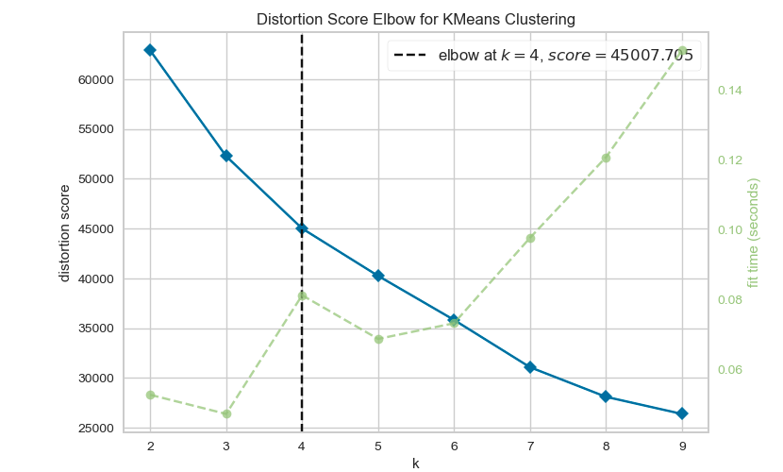

Slide 6
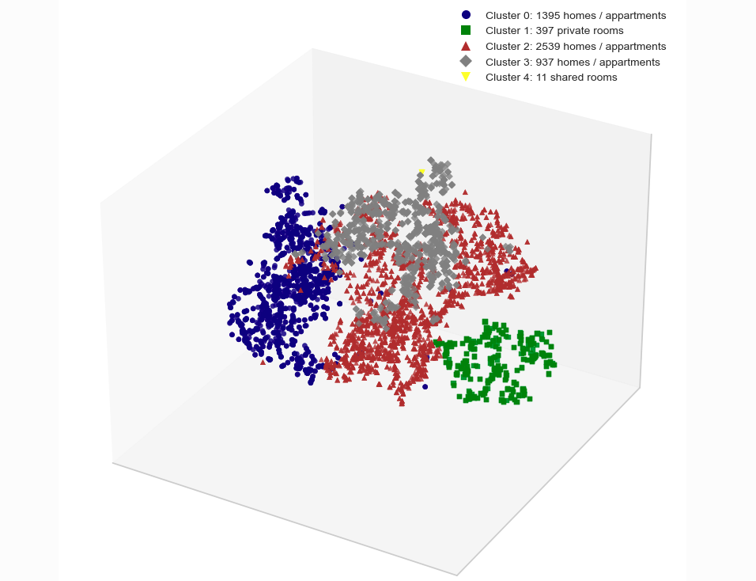
3D Visualization: Room types distribution

Slide 7
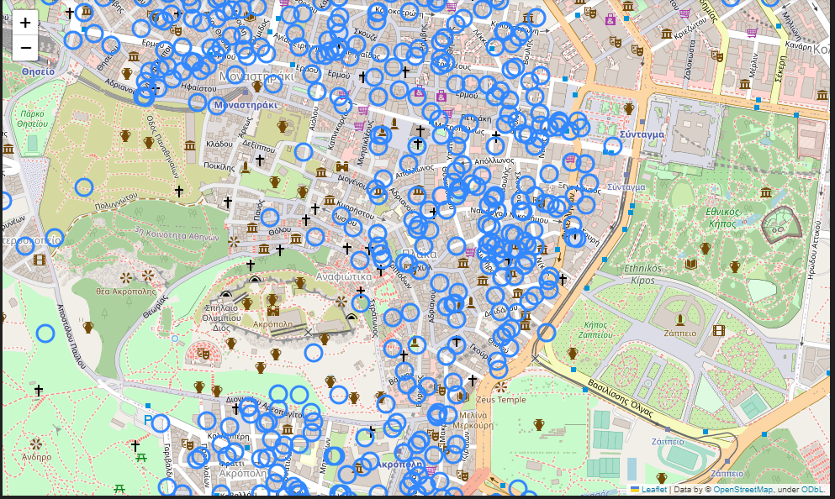
Location of the expensive listings

Slide 8
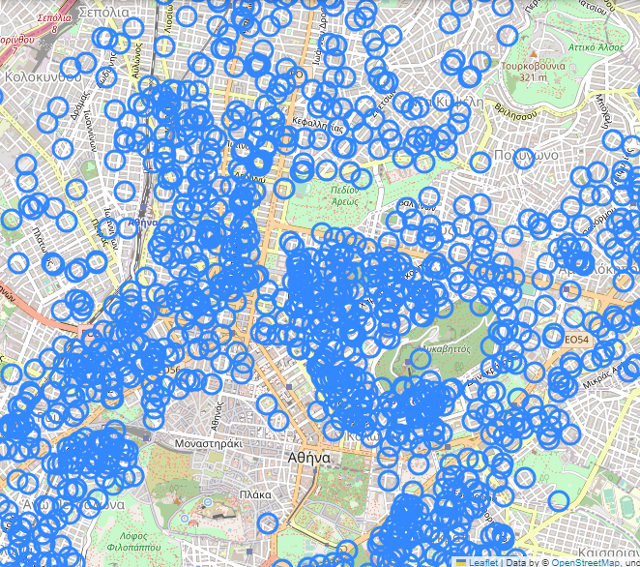
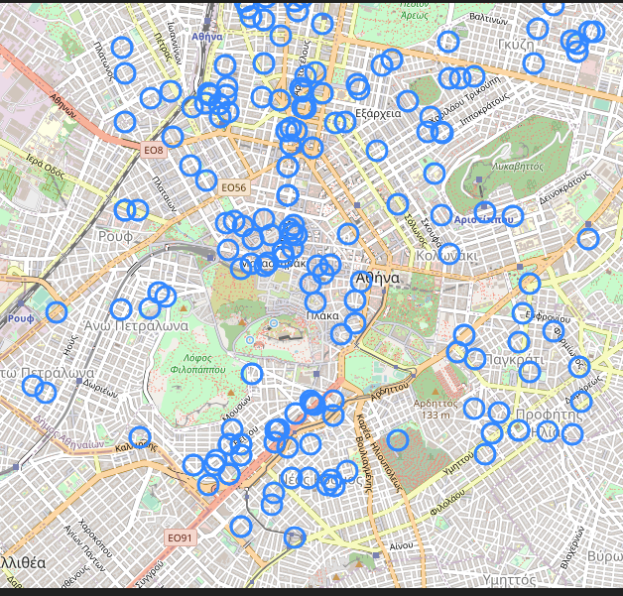
The location of cheap listings in comparison to private rooms

Slide 9
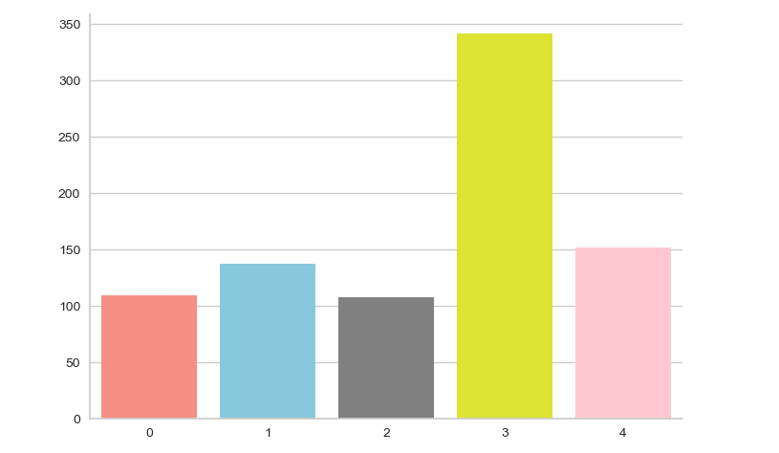
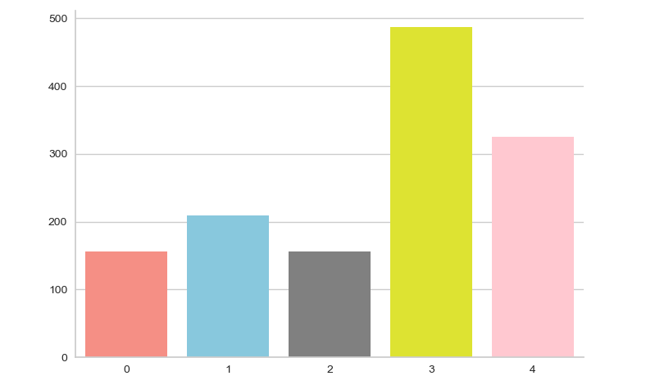
Attraction Indexes per Cluster
Restaurant Indexes per Cluster

Slide 10
THANK YOU!!

